Slide 1
A1 - Experiments with Machine Learning
By: Shirwa Warsame
Jeremie Chouteau-Lapierre Jeff Buonamici
Paul Micu
SOEN 472 - Artificial Intelligence

Slide 2
Initial Dataset - Description
Name : “all_sentiment_shuffled.txt”
The given dataset is a set of reviews from 6 different topics the following being: books, camera, dvd, health, music, or software. Each line of the dataset corresponds to a single review. Each review is split into columns which are, • 0: topic category label • 1: sentiment polarity label • 2: document identifier • 3 and on: the words in the document.
For this assignment, we are interested in (1), which is either negative or positive, as well as (3) and the correlation between the 2.

Slide 3
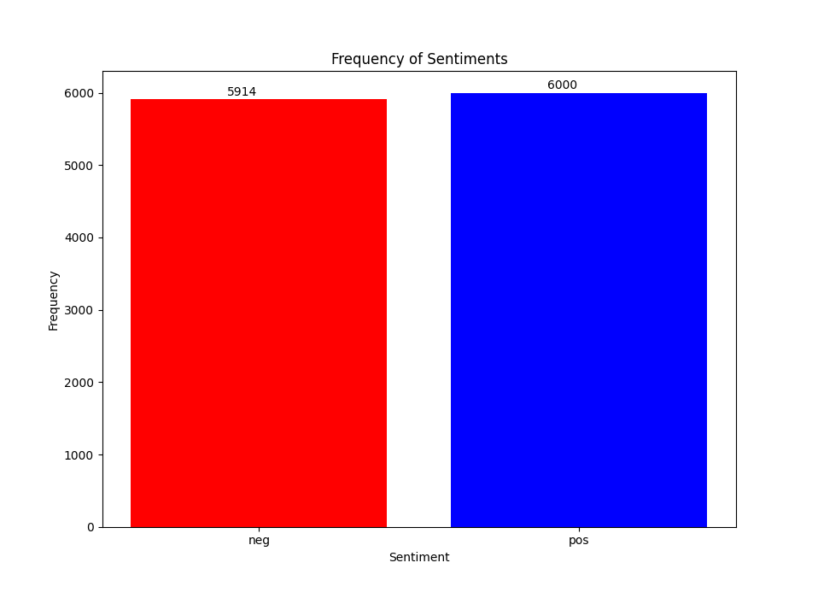
Initial Dataset - Label Distribution

Slide 4
Initial Dataset - Observation/Analysis
Some reviews are less than 10 words
Smaller the review, worst are the probabilities of predicting. Filler words (impurities) have a higher impact
ex:[11472] real: pos “goo”
Long reviews tend to give both negative and positive comments.
Even though the class of the review is either positive or negative, long reviews tend to give out mixed comments
Ex:

Slide 5
Initial Dataset - Observation/Analysis (Cont.)
Spelling mistakes
Spelling mistakes create new features in the vocabulary, reducing the frequency of the feature in the training documents, leading to more errors in training the classifier
Ex: [10719]: real: neg “never recueved the product”
Some reviews seem to be wrongly labeled
Reviews identified as negative have mostly positive comments and vice versa
Ex: [9629]: real: neg “the cd came as promised and in the condition promised . i 'm very satisfied”

Slide 6
Naive-Bayes - Results
Accuracy: 83%
Performance Analysis
Precision recall f1-score support
pos 0.84 0.80 0.82 1153
neg 0.82 0.86 0.84 1230
accuracy 0.83 2383
macro avg 0.83 0.83 0.83 2383
weighted avg 0.83 0.83 0.83 2383

Slide 7
Base-DT - results
Accuracy: 62%
Performance Analysis
Precision recall f1-score support
pos 0.59 0.68 0.63 1153
neg 0.65 0.56 0.60 1230
accuracy 0.62 2383
macro avg 0.62 0.62 0.62 2383
weighted avg 0.62 0.62 0.62 2383

Slide 8
Best-DT - Results
Accuracy: 64%
Performance Analysis
Precision recall f1-score support
pos 0.71 0.52 0.60 1230
neg 0.60 0.77 0.68 1153
accuracy 0.64 2383
macro avg 0.66 0.65 0.64 2383
weighted avg 0.66 0.64 0.64 2383

Slide 9
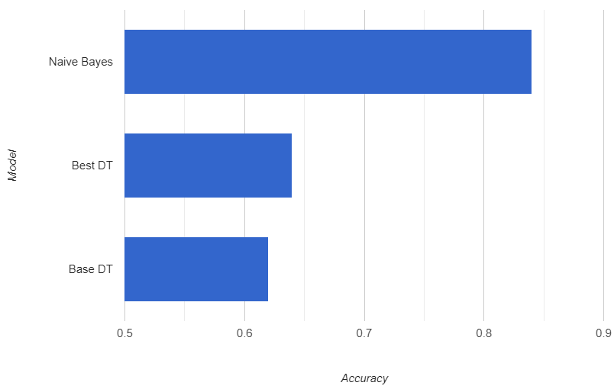
Model Accuracy Comparison

Slide 10
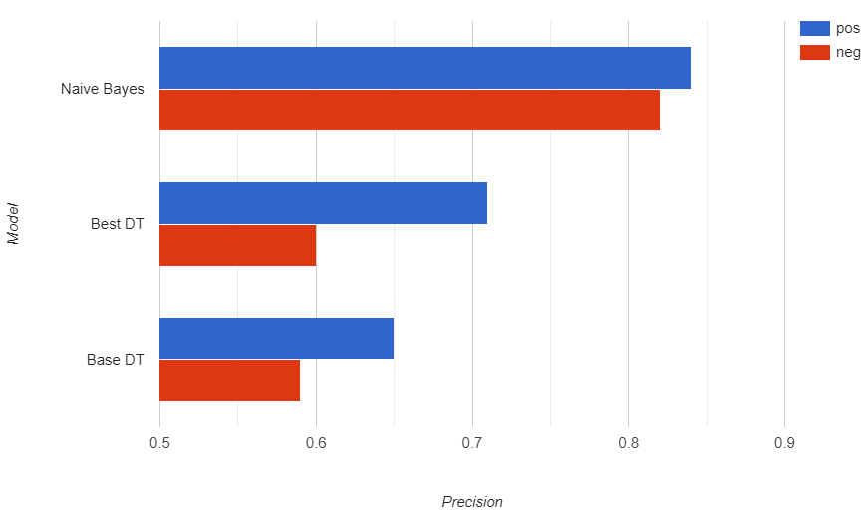
Model Precision Comparison
Notes:
The Reason why Precision is important, is because it shows how good a model

Slide 11
Model Observations - parameters
Naive-Bayes: base version vs “best version”:
Accuracy difference: less than 0.5 %.
Mutlinominal vs MultinomialNB(alpha=9.3, fit_prior='true')
Decision Tree
Base Accuracy: 60-63% vs Best accuracy:63-67%
Best-DT:
Everytime the model gets trained (program run) -> accuracy varies
Between 63 and 67%
Everytime we search for the best parameters -> the results differ:
{'criterion': 'gini', 'max_depth': 8, 'min_samples_leaf': 4, 'min_samples_split': 7, 'splitter': 'random'}
{'criterion': 'gini', 'max_depth': 9, 'min_samples_leaf': 3, 'min_samples_split': 9, 'splitter': 'random'}

Slide 12
Model Comparison Analysis
DT is worst in extrapolation due to:
Over-fitting: the dataset given has a lot of “impurities”. This leads the decision tree in the wrong path from which he can’t recover
Ex: “The”, “this”, ...
Not continuous: a cluster of words(docs) will be either labeled as negative or positive, there is no scaling of classes for a certain feature.
Random Forest might have been able to alleviate DT’s downsides by giving weights to the class outcome of a doc

Slide 13
Members responsibilities and contributions
Shirwa warsame: - Project setup, tasks 0-3, presentation, document of errors
Jeff Buonamici: - tasks 1-4, presentation, document of errors
Paul Micu: - tasks 1-4, presentation, document of errors
Jérémie Chouteau: - tasks 0-4, presentation

